Slide 1
Non Functional Testing

Slide 2
This section is based upon the testing of the application from its non-functional attributes.
Non-functional testing of Software involves testing the Software from the requirements which are non-functional in nature related but important a well such as performance, security, user interface etc.

Slide 3
Non Functional Testing
Compatibility Testing
Performance Testing
Endurance Testing
Load Testing
Volume Testing
Scalability Testing
Spike Testing
Stress Testing
Internationalization Testing
Recovery Testing
Security Testing
Usability Testing

Slide 4
Compatibility Testing
Compatibility testing is a non-functional testing conducted on the application to evaluate the application's compatibility within different environments. It can be of two types - forward compatibility testing and backward compatibility testing.
Operating system Compatibility Testing - Linux , Mac OS, Windows
Database Compatibility Testing - Oracle SQL Server
Browser Compatibility Testing - IE , Chrome, Firefox
Other System Software - Web server, networking/ messaging tool, etc.

Slide 5
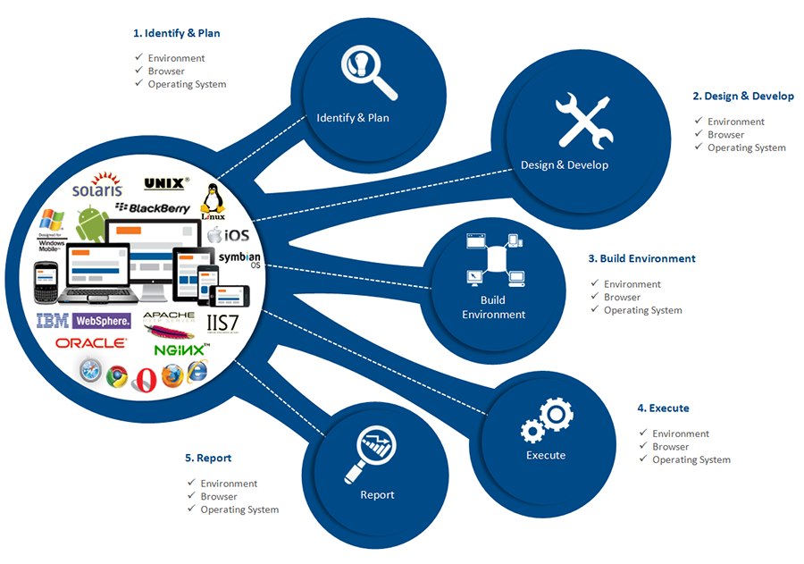

Slide 6
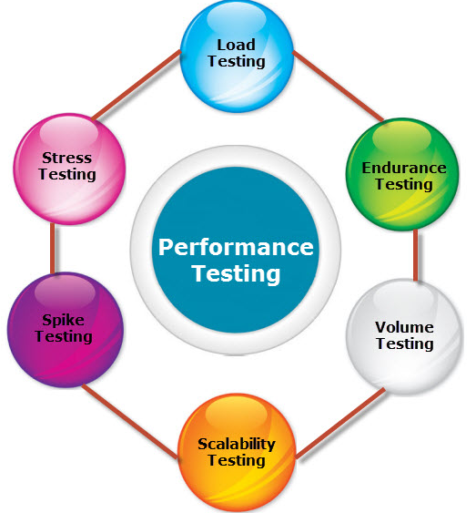
Performance Testing

Slide 7
Endurance Testing
Endurance Testing also known as Soak Testing is performed to determine if the application under test can sustain the continuous loads.
Endurance testing, non-functional testing involves examining the system if it can withstand a huge load for a longer period of time and thereby measuring the system's reaction parameters.

Slide 8
Issues
Serious memory leaks that would eventually result in application or Operating System crash
Failure to close connections between the layers of the system could stall some or all modules of the system.
Failure to close database connections under some conditions might result in complete system crash.
Gradual degradation of response time of the system as the application becomes less efficient as a result of prolonged test.

Slide 9


Slide 10
Volume Testing
Volume testing is a Non-functional testing that is performed as part of performance testing where the software is subjected to a huge volume of data. It is also referred as flood testing.

Slide 11
Characteristics of Volume Testing
During development phase, only small amount of data is tested.
The performance of the software deteriorates over time as there is enormous amount of data overtime.
Test cases are derived from design documents.
Test data is usually generated using a test data generator.
Test data need not be logically correct but the data is to assess the system performance.
Upon completion of testing, results are logged and tracked to bring it to closure.

Slide 12
Checklist of Volume Testing
Verify if there is any data loss.
Check the system's response time.
Verify if the data is stored incorrectly.
Check if the data is overwritten without any notification.

Slide 13
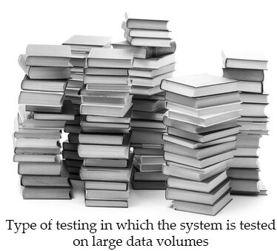

Slide 14
Load Testing
Load testing is performance testing technique using which the response of the system is measured under various load conditions. The load testing is performed for normal and peak load conditions.

Slide 15
Load Testing Approach:
Evaluate performance acceptance criteria
Identify critical scenarios
Design workload Model
Identify the target load levels
Design the tests
Execute Tests
Analyze the Results
Objectives of Load Testing:
Response time
Throughput
Resource utilization
Maximum user load
Business-related metrics

Slide 16


Slide 17


Slide 18


Slide 19
Stress Testing
Stress testing a Non-Functional testing technique that is performed as part of performance testing. During stress testing, the system is monitored after subjecting the system to overload to ensure that the system can sustain the stress.
The recovery of the system from such phase (after stress) is very critical as it is highly likely to happen in production environment.

Slide 20
Reasons for conducting Stress Testing:
It allows the test team to monitor system performance during failures.
To verify if the system has saved the data before crashing or NOT.
To verify if the system prints meaning error messages while crashing or did it print some random exceptions.
To verify if unexpected failures do not cause security issues.
Stress Testing - Scenarios:
Monitor the system behaviour when maximum number of users logged in at the same time.
All users performing the critical operations at the same time.
All users Accessing the same file at the same time.
Hardware issues such as database server down or some of the servers in a server park crashed.

Slide 21
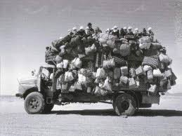

Slide 22
Scalability Testing
Scalability, a performance testing parameter that investigates a system's ability to grow by increasing the workload per user, or the number of concurrent users, or the size of a database.
able to be changed in size or scale

Slide 23
Scalability Testing Attributes:
Response Time
Throughput
Hits per second, Request per seconds, Transaction per seconds
Performance measurement with number of users
Performance measurement under huge load
CPU usage, Memory usage while testing in progress
Network Usage - data sent and received
Web server - Request and response per second

Slide 24


Slide 25
Spike Testing
Spike Testing is a form of testing process in which an application is tested with unusual increment and decrements in the load.
The system is unexpectedly loaded and unloaded.
It is done to notice how actually the system reacts with unexpected rise and decline of users.
The goal of spike testing is to regulate whether performance will deteriorate, the system will always fail, or it will be able to hold dramatic changes in load.
A spike is a keen rise in the density for a given variable, generally immediately followed by a decrease. This category of transient variation is often notice in the measurement of voltage or you can say current in circuits.

Slide 26


Slide 27
Internationalization Testing
Aim of Internationalization and Localization testing is to make sure usability, acceptability, reliability to audience and users worldwide & check whether the application under test is ready for world-readiness.
First application under test needs to be localized & then tested for many other counts like locale, copy text, language, compatibility, reliable functionality and interoperability.

Slide 28
I18N - Internationalization
G11N – Globalization
L10N - Localization

Slide 29
Globalization Testing
Globalization definition: Globalization Testing is testing process to check whether software can perform properly in any locale or culture & functioning properly with all types of international inputs and steps to effectively make your product truly global.
This type of testing validates whether the application is capable for using all over the world and to check whether the input accepts all the language texts.
It ensures that the product will handle international support without breaking functionality.

Slide 30
Localization definition: Localization testing is testing process to validate whether application is capable enough for using in a particular location or country. In this testing localization, testing is to carried out to check the quality of the product for particular locale/culture.
To check the quality of translation in localization testing, we should request local staff as well.
It is to be carried out to check the localized version of the product, For example: French product for French users

Slide 31
Let’s see another example of a Zip code field in Sign up form: 1) For globalized, it should allow to enter alphanumeric inputs 2) For localized (country like INDIA), it should allow only numbers in input field.

Slide 32


Slide 33
Recovery Testing
Recovery testing is a type of non-functional testing technique performed in order to determine how quickly the system can recover after it has gone through system crash or hardware failure.
Recovery testing is the forced failure of the software to verify if the recovery is successful.

Slide 34
Recovery Plan - Steps:
Determining the feasibility of the recovery process.
Verification of the backup facilities.
Ensuring proper steps are documented to verify the compatibility of backup facilities.
Providing Training within the team.
Demonstrating the ability of the organization to recover from all critical failures.
Maintaining and updating the recovery plan at regular intervals.

Slide 35
Security Testing
Security testing is a testing technique to determine if an information system protects data and maintains functionality as intended. It also aims at verifying 6 basic principles as listed below:
Confidentiality
Integrity
Authentication
Authorization
Availability
Non-repudiation (Surety)

Slide 36


Slide 37
Usability Tsting
Usability Testing is a type of testing done from an end-user’s perspective to determine if the system is easily usable.
Testing to determine the extent to which the software product is understood, easy to learn, easy to operate and attractive to the users under specified conditions.

Slide 38
Usability testing is a way to see how easy to use something is by testing it with real users.
Users are asked to complete tasks, typically while they are being observed by a researcher, to see where they encounter problems and experience confusion. If more people encounter similar problems, recommendations will be made to overcome these usability issues.

Slide 39
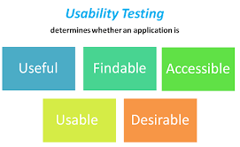

Slide 40
Thank You

